Slide 1

Where should We live
Lan Pham, Sadi Khatiwada

Slide 2
Project Goal!
Using Machine Learning to predict a model and see its accuracy as predicting happiness score from given X variables

Slide 3
World Happiness Data 2017-2019
Happiness score
GDP per capita- Gross Domestic Product per person, comparisons of average living standards and economic wellbeing
Healthy Life Expectancy (HLE)- extracted from the World Health Organization’s (WHO), life expectancies at birth.
Social support- having someone to count on in times of trouble
Freedom- responses to “Are you satisfied or dissatisfied with your freedom to choose what you do with your life?”
Generosity- response “Have you donated money to a charity in the past month?” per capita.
Corruption Perception: average response of “Is corruption widespread throughout the government or not” and “Is corruption widespread within businesses or not?”

Slide 4
Countries with a high Healthy life expectancy at birth tend to be happier on average.
Does it mean that ensuring a good healthcare system would increase people happiness?
The higher one’s wealth and social support are, the happier he/she is.
Is that right?

Slide 5
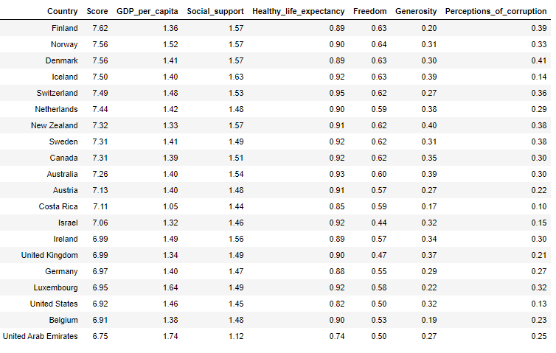
Regression analysis- to quantify the relationship between one variable and the other variables

Slide 6
Assign data X = “GDP_per_capita", "Social support", "Healthy_life_expectancy", "Freedom", "Generosity", "Perceptions_of_corruption" y = “Score"
Create the model using Linear Regression
model = linear_model.LinearRegression()
Fitting our model with all of the features in X
model.fit(X, y)
score = model.score(X, y)

Slide 7
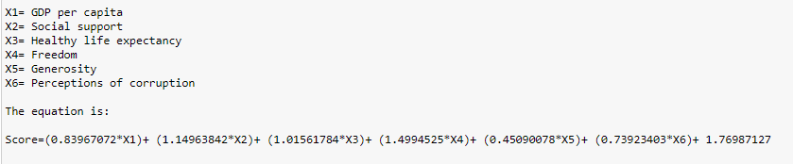

Slide 8
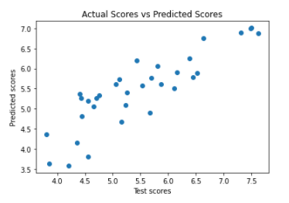
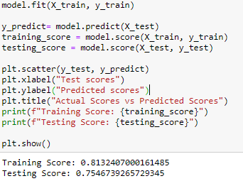
Create model
create training and testing data
X_train, X_test, y_train, y_test = train_test_split(X, y,test_size = 0.2)

Slide 9
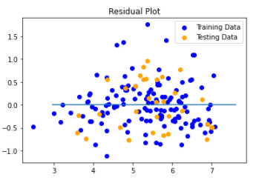
Residual Plot- the difference between the true values of y and the predicted values of y

Slide 10
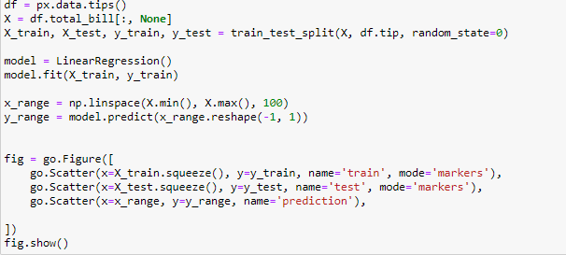
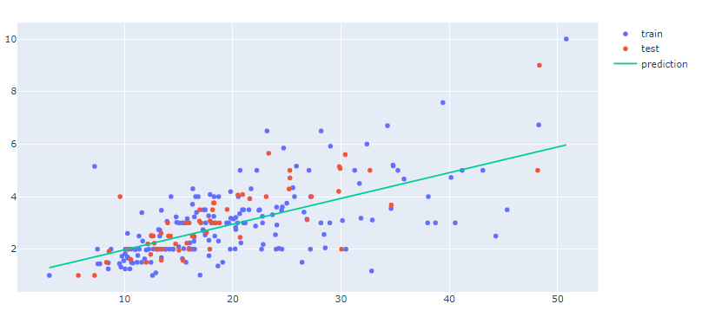
Actual vs Prediction

Slide 11
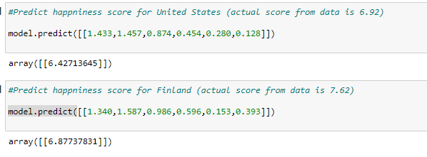
Predict happiness score

Slide 12
